Slide 1




Introduction to Causal Inference for Software Engineering
A 90-minute hands-on tutorial
Julien Siebert · Julian Frattini · Hans-Martin Heyn · Roberto Pietrantuono

Slide 2
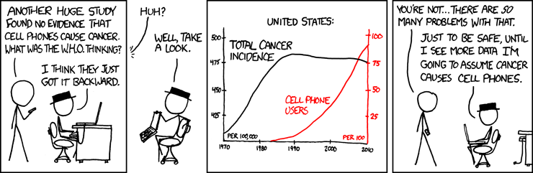
Section 3a
Basic Causal Structures
Basic Causal Structures
https://xkcd.com/925/
2

Slide 3
The “building blocks” of causal models
Confounder
(or: fork)
z is a common cause of both exposure x and the outcome y
Mediator
(or: pipe)
z is an effect of exposure x and a cause the outcome y
Collider
z is a common effect of both exposure x and the outcome y
x
y
x
y
x
y
z
z
z

Slide 4
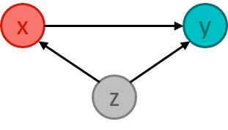

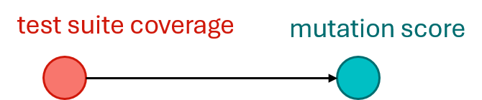
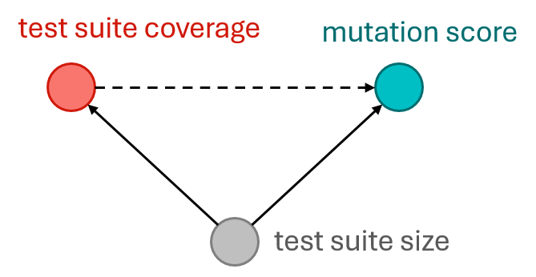
Confounder
“Coverage Is Not Strongly Correlated with Test Suite Effectiveness”
Inozemtseva, L., & Holmes, R. (2014, May). Coverage is not strongly correlated with test suite effectiveness. In Proceedings of the 36th international conference on software engineering (pp. 435-445).
Most Influential Paper at ICSE’24

Slide 5
Confounder
test suite coverage
mutation score
A higher test suite coverage is associated with test suite size which leads to higher effectiveness (mutation score).
A higher test suite coverage, however, does not cause a higher test suite size!
When not controlling the confounder, “information flows” from the cause through the confounder to the effect in a non-causal direction.
test suite size
If both treatment and outcome have a common cause, we need to statistically adjust for (i.e., control) the confounder to de-bias the effect of interest.

Slide 6
Mediator
x
y
z
Company Y tested a new technique in their requirements engineering phase that is enabled by a prototype tool. We investigated whether this technique improved the engineers’ productivity.”
On its own, the new technique lifts productivity.
To enforce the technique, a rigid, form-heavy tool is introduced. Engineers dislike the tool.
A strong tool appeal increases productivity.
Overall, the new technique leads to less productivity.
technique
productivity
tool appeal

Slide 7
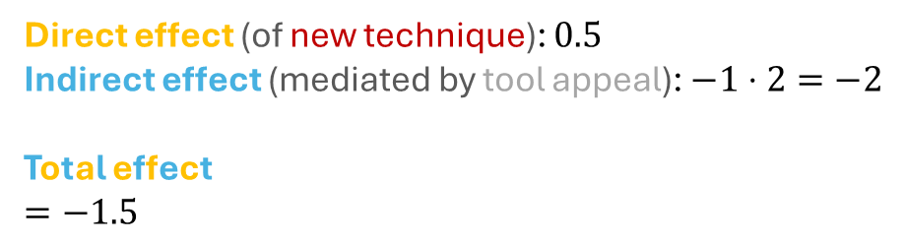








Mediator
x
y
z
technique
productivity
$$−1.5$$
$$m_{1}:productivity \sim technique$$
$$m_{1}:$$
$$m_{2}:productivity\sim technique+appeal$$
technique
productivity
Direct effect (of new technique): $0.5$
Indirect effect (mediated by tool appeal): $−1⋅2=−2$
Total effect
$$=−1.5$$
$$0.5$$
$$m_{2}:$$
$$−1$$
$$2$$
= Direct effect + Indirect effect
tool appeal
$$=0.5+−2$$
We need to statistically control for a mediator, if we want to distinguish between the direct and indirect effect of a treatment on an outcome.

Slide 8


Collider
x
y
z
Does the length of a requirements specification affect its quality? Both factors do affect whether the specified feature is implemented successfully.
$$m_{1}:quality\sim size+success$$
specification size
specification quality
$$m_{2}:quality\sim size$$
feature success

Slide 9
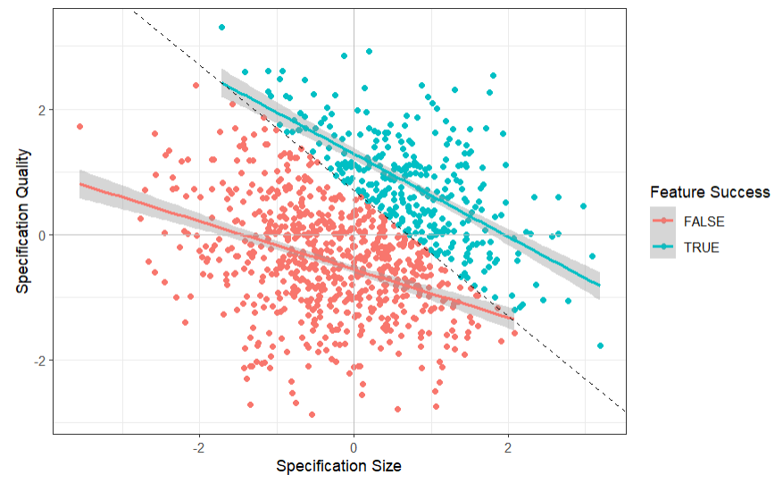
Collider
x
y
z
Does the length of a requirements specification affect its quality? Both factors do affect whether the specified feature is implemented successfully.
$$m_{1}:quality\sim size+success$$
specification size
specification quality
feature success

Slide 10
Collider
x
y
z
Does the length of a requirements specification affect its quality? Both factors do affect whether the specified feature is implemented successfully.
$$m_{1}:quality\sim size+success$$
For any high quality value, if feature success is false, then it is more likely that the specification size was small.
For any low quality value, if feature success is true, then it is more likely that the specification size was large.

Slide 11
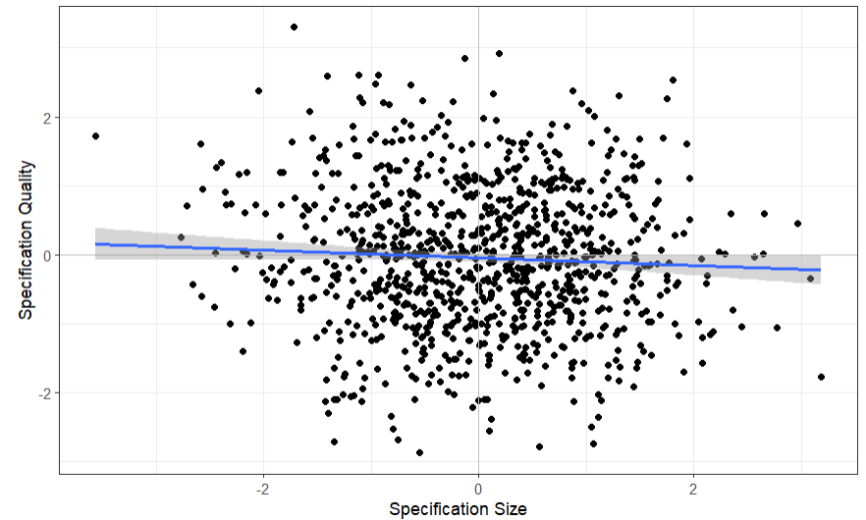

Collider
x
y
z
Does the length of a requirements specification affect its quality? Both factors do affect whether the specified feature is implemented successfully.
$$m_{2}:quality\sim size$$
specification size
specification quality

Slide 12

Collider
x
y
z
Does the length of a requirements specification affect its quality? Both factors do affect whether the specified feature is implemented successfully.
$$m_{1}:quality\sim size+success$$
specification size
specification quality
$$m_{2}:quality\sim size$$
If both treatment and outcome have a common effect, we must not condition on this common effect. Consequently, we cannot simply add all relevant variables as predictors.
feature success

Slide 13
The “building blocks” of causal models
Confounder
(or: fork)
z is a common cause of both exposure x and the outcome y
Mediator
(or: pipe)
z is an effect of exposure x and a cause the outcome y
Collider
z is a common effect of both exposure x and the outcome y
x
y
x
y
x
y
z
z
z
To get an unbiased estimation of the effect x → y we must control z.
To get the direct effect x → y we must control z. To get the total effect, we must not control z.
To get the direct effect x → y DO NOT DO ANYTHING (with z)!

Slide 14
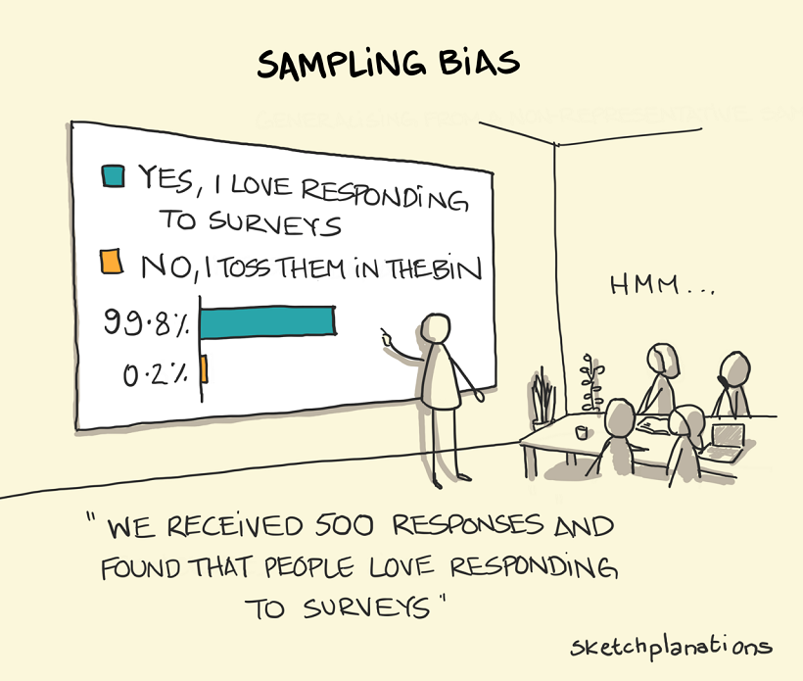
Section 3b
d-separation
https://sketchplanations.com/sampling-bias
14

Slide 15


Causal Modelling
Causal modelling is imperative for drawing the correct conclusions when conducting statistical causal inference.
We cannot infer causality from data alone – we must also know the process that created that data.
Causal Model
Statistical Model
z
Confounder
$$m:y\sim x+z$$
x
y
z
But how does this approach scale beyond three variables?
x
y
Collider
$$m:y\sim x$$

Slide 16
d-separation
Given my DAG and my exposure and outcome of interest, d-separations answers which variables to include in a statistical / ML model to get an unbiased causal estimate.
These variables that “block confounding backdoor paths of association” are called an adjustment set.
Practical intuition:
Include confounders (common causes of both exposure and outcome).
Include mediators, if you are interested in the direct effect.
Do not include colliders (common effects of both exposure and outcome).
Once a backdoor path is closed, the flow of “anti-causal” association is blocked, and you won’t need to control for more confounding variables.

Slide 17

d-separation example
Model Derivation
$$m:b\sim a$$
c
d
a
b
e
f
g

Slide 18
d-separation example
Adjustment set = {}
Model Derivation
$$m:b\sim a$$
c
d
Identify every backdoor path
a
b
e
f
g

Slide 19

d-separation example
Adjustment set = {}
Model Derivation
$$m:b\sim a$$
c
d
Identify every backdoor path
Check if there is a collider between the cause and effect of interest.
If yes, do not condition on any of the variables on this path.
a
b
e
f
g

Slide 20

d-separation example
Adjustment set = {f}
Model Derivation
$$m:b\sim a+f$$
c
d
Identify every backdoor path
Check if there is a collider between the cause and effect of interest.
If yes, do not condition on any of the variables on this path.
If not, condition on any of the variables on this path to “close” the backdoor path.
a
b
e
f
g

Slide 21
d-separation example
Adjustment set = {f,(e)}
Model Derivation
$$m:b\sim a+f$$
c
d
Identify every backdoor path
Check if there is a collider between the cause and effect of interest.
If yes, do not condition on any of the variables on this path.
If not, condition on any of the variables on this path to “close” the backdoor path.
Optionally, condition on mediators to isolate the direct effect.
a
b
e
f
g

Slide 22

Workflow for Statistical Causal Inference
1) Modelling
Creating a DAG of assumed causal relationships
x
y
z
2) Identification
Define a statistical / ML model from the causal model
x
y
Model Derivation
$$y\sim x+z$$
z
3) Estimation
Training a statistical model with the observed data and evaluating the results
Siebert, J. (2023). Applications of statistical causal inference in software engineering. IST, 159, 107198.

Slide 23
Scientific Workflow: Traditional
Data Collection
Assumed DAG
Collected Data
Modelling
x | y
z
Identification
x
y
Estimation
Not collecting data about a confounder will threaten the internal validity of your results

Slide 24
Scientific Workflow: Better
Modelling
Assumed DAG
Collected Data
hard-to-measure
confounder
x | y | z
Identification
z
Data Collection
x
y
Estimation
Too often, we derive hypotheses from the data available to us.

Slide 25
Scientific Workflow: Best
Modelling
Assumed DAG
Collected Data
z
x | y | z | a
 |  |  | x
 |  |  | x
 |  |  | x
 |  |  | x
Identification
x
y
Data Collection
Alternate Strategy
a
feasible?
Unobservable confounder
Estimation
Unobservable confounders require (a) acknowledgement in the threats to (internal) validity and (b) different research strategies.

Slide 26
Summary causal structures and d-separation
We discussed the need to model our causal assumptions about the data generating process in observational studies using DAGs.
Confounders, Mediators, and Colliders are different structural patterns in a DAG that influence the flow of association.
d-separation helps us to determine which variables to include or exclude in a statistical or ML model to avoid biased effect estimates.
Causal Workflow: Modelling -> Identification -> Data Collection -> Estimation

